Slide 1


Open Community
Welcomes You All
Open Community
FOR
“RPA 3.0”

Slide 2

Don’t Forget to mark your Attendance!

Slide 3
WHO ARE WE?
On 18th Jan 2019 with the support of various global IT giants and organizations of repute including STPI, Xebia, IBM and TechMint.
Working on open source projects that lead towards various advancements and innovation by providing the right support and mentorship to students is our motto.
Our Motto – Aware , Adopt and Contribute
Visit our Official Website: https://upes-open.org/

Slide 4
AGENDA EXPLORING RPA : Careers and Opportunities

Slide 5
Next Steps

Slide 6


Mukesh Kala
3 *UiPath Most Valuable Professional
YouTube : Tutorials by Mukesh Kala
https://mukeshkala.com

Slide 7


Medhavi Singh
Project Dev. Lead – Open Community
2022-23 UiPath Student Champion
UPES Dehradun

Slide 8





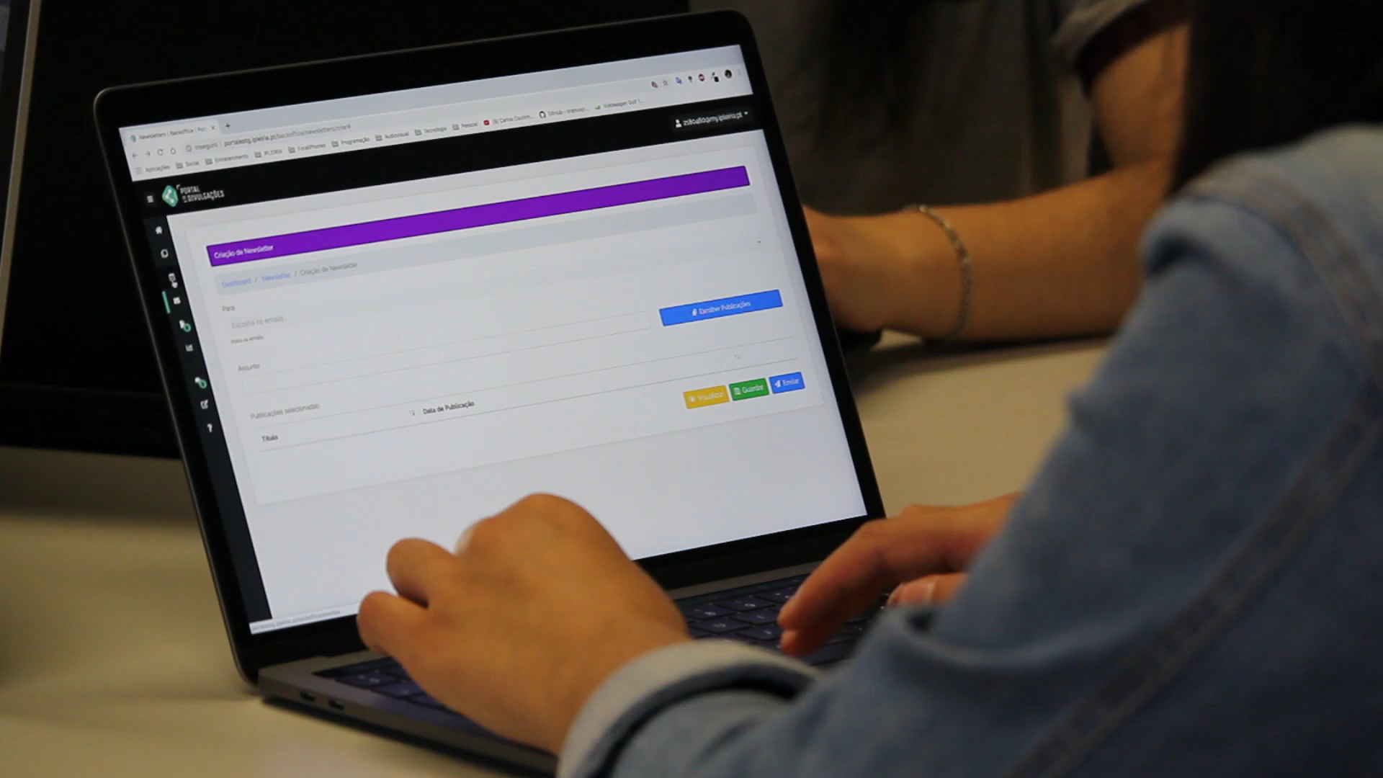
What is RPA?
RPA is the technology that enables a software program to mimic human actions while interacting with computer applications to accomplish required tasks. Some human interactions that can be automated are:
Keyboard inputs
Mouse movements and clicks
Reading computer screen

Slide 9







Use of RPA in Business
Some examples where RPA is deployed in businesses departments today are:
Education
Supply Chain
IT
HR
Enrolment Process
Attendance Robot
Scheduling Meetings
Classroom and Online Learning
Answering Queries
Library Robots - Alerts
Inventory management
Invoice & contract management
Server & app monitoring
Routine maintenance & monitoring
Payroll
Onboarding & offboarding
Client Services
Accounting
Operations
Address change
Scheduling appointments
Accounts/Reports Reconciliation
Account Creation & Update
Order Creation & Update
Work Order Request

Slide 10





Global : Automation Growth & Prospects
Future of work – Global
97
million
By 2025, 85 million jobs may be replaced, and 97 million new roles created, with new relationships between humans, machines, and algorithms
Future of Work Report 2020 – WEF
RPA Market Size Growth Global
32.8%
CAGR
The global Automation market size is anticipated to exhibit a CAGR of 32.8% over the forecast period from 2021 to 2028 for a worth of 13.74 billion in 2028 from 1.57 billion in 2020.
www.grandviewresearch.com
Automation Job Roles In Demand
Below are the various RPA job roles that are in great demand globally-
RPA Developer
RPA Engineer
RPA Technical Lead
RPA Solutions Senior Developer
RPA Consultant
RPA Administrator
RPA Business Analyst
RPA Data Analyst
RPA Project Manager
RPA Process Architect
RPA Tester
RPA Support
Rapid Business Transformation Global
84%
Eighty-four percent of employers are set to rapidly digitize working processes.
Future of Work Report 2020 – WEF
https://www.koenig-solutions.com/blog/rpa-developer-roles-and-responsibilities

Slide 11

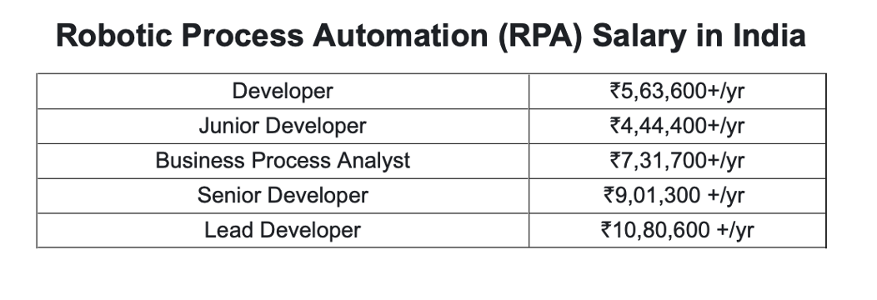
APJ: Automation - Growth & Prospects
Automation will be a critical requirement
86%
Organizations in APJ agree that automation will be a critical requirement for business excellence, customer experience, and competitive success within the next 3 years
IDC InfoBrief -Automation Mindset Asia/Pacific
Talent Shortage
59%
Talent crunch has become a significant business challenge as 59% of surveyed APJ organizations. The IDC report points to the shortage of automation skills and talent as the top challenge they face in scaling automation.
IDC InfoBrief -Automation Mindset Asia/Pacific
Talent Growth in Major IT Capitals
32% Growth
The top 7 cities with Automation Developer talent are in APJ and each city has been seeing an average 32% growth
Linkedin Jobs Insight July 2022
https://www.koenig-solutions.com/blog/rpa-career-opportunities

Slide 12


By working with robots, employees save time – unlocking capacity at scale
Estimated time savings by providing a digital assistant to one employee
Estimated time savings by providing a digital assistant to 15k employees
240 hours per year
3.6M+ hours per year
1 hour per day 20 hours per month
To take advantage of the opportunity we need to educate individuals to have an Automation Intent Mindset (AIM)

Slide 13
Intelligent Process Automation
Intelligent automation is a combination of artificial intelligence (AI) and automation technologies that work together to automate business processes and decision-making.
Intelligent automation can be used in a variety of industries, including manufacturing, healthcare, finance, and customer service.
It involves using machine learning, natural language processing, and other AI technologies to improve the efficiency and accuracy of business processes, while also reducing the need for human intervention.
It can be used for tasks such as data entry, document processing, customer support, and even complex decision-making processes. By using intelligent automation, businesses can reduce costs, increase productivity, and improve the overall quality of their products or services.

Slide 14
Benefits
Increased Efficiency: Intelligent automation can automate repetitive and time-consuming tasks, allowing employees to focus on more strategic and high-value activities. This can lead to increased productivity and efficiency.
Improved Accuracy: Intelligent automation technologies such as machine learning and natural language processing can improve the accuracy of business processes, reducing errors and improving the overall quality of work.
Cost Savings: By automating tasks that were previously done manually, businesses can reduce labor costs and increase cost savings.
Faster Processing: With intelligent automation, businesses can process data and information more quickly and accurately than humans, leading to faster decision-making and better outcomes.
Enhanced Customer Experience: By automating customer service tasks, such as answering frequently asked questions or resolving common issues, businesses can improve the overall customer experience.
Scalability: Intelligent automation can easily scale up or down to meet changing business demands, allowing businesses to adapt to changing market conditions quickly.
Overall, intelligent automation can help businesses streamline their operations, reduce costs, and improve the quality of their products or services, leading to increased customer satisfaction and profitability.

Slide 15
Applications
Customer Service: Intelligent automation can be used to automate customer support tasks, such as answering frequently asked questions or resolving common issues, leading to enhanced customer experience.
Manufacturing: In manufacturing, intelligent automation can be used for quality control, predictive maintenance, and supply chain management.
Finance: In finance, intelligent automation can be used for fraud detection, risk management, and regulatory compliance.
Healthcare: In healthcare, intelligent automation can be used for medical data analysis, patient monitoring, and personalized treatment planning.
Human Resources: In human resources, intelligent automation can be used for recruitment, onboarding, and performance evaluation.
Retail: In retail, intelligent automation can be used for inventory management, personalized marketing, and customer support.
Logistics: In logistics, intelligent automation can be used for route optimization, shipment tracking, and warehouse management.

Slide 16
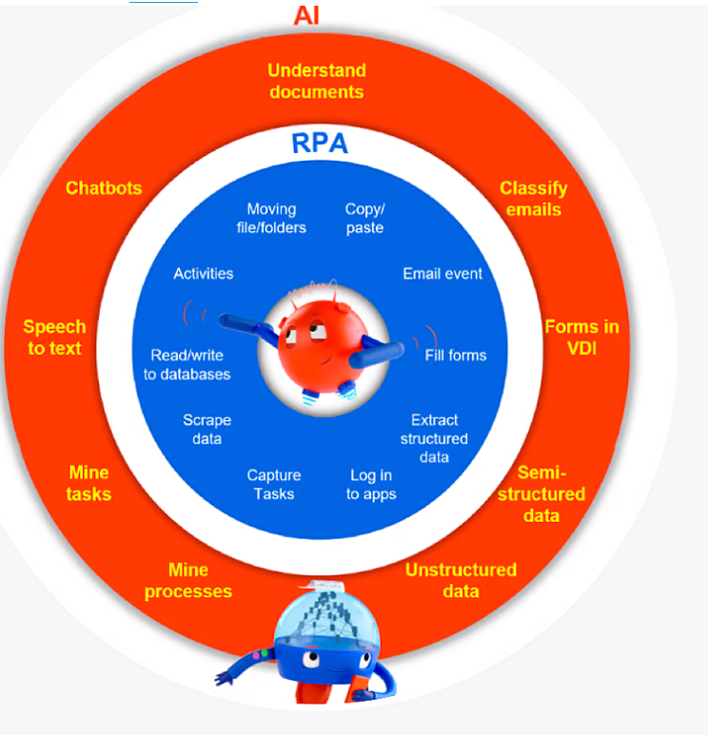
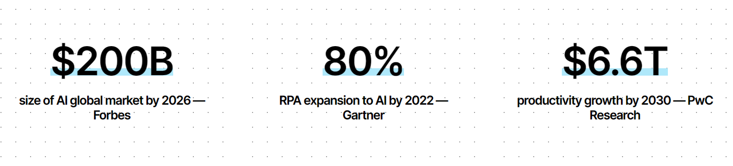
RPA and the AI
https://www.uipath.com/automation/ai-and-rpa

Slide 17
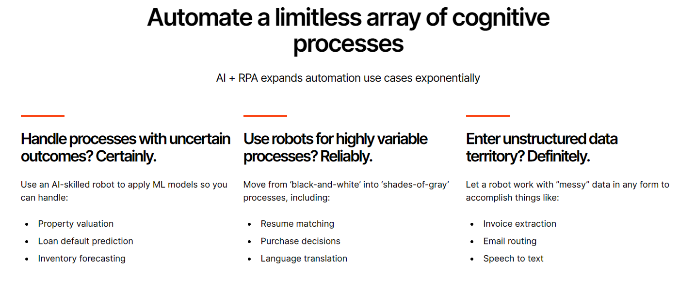


Slide 18




Vibrant ecosystem of more than 2 million professionals and citizen developers learning,
getting support, and succeeding together in their automation careers.
Academy
Learn the skills of the future on UiPath Academy or through our Academic Alliance
Earn globally recognized credentials with UiPath Certifications
Forum
Get crowdsourced support and share product feedback on UiPath Forum
Check the product documentation
Community Events
Connect with like-minded people and share best practices with the UiPath Community
Solve challenges in engaging hackathon competitions
Join meetups and conferences

Slide 19





Thank You
YouTube : Tutorials by Mukesh Kala
https://mukeshkala.com

Slide 20
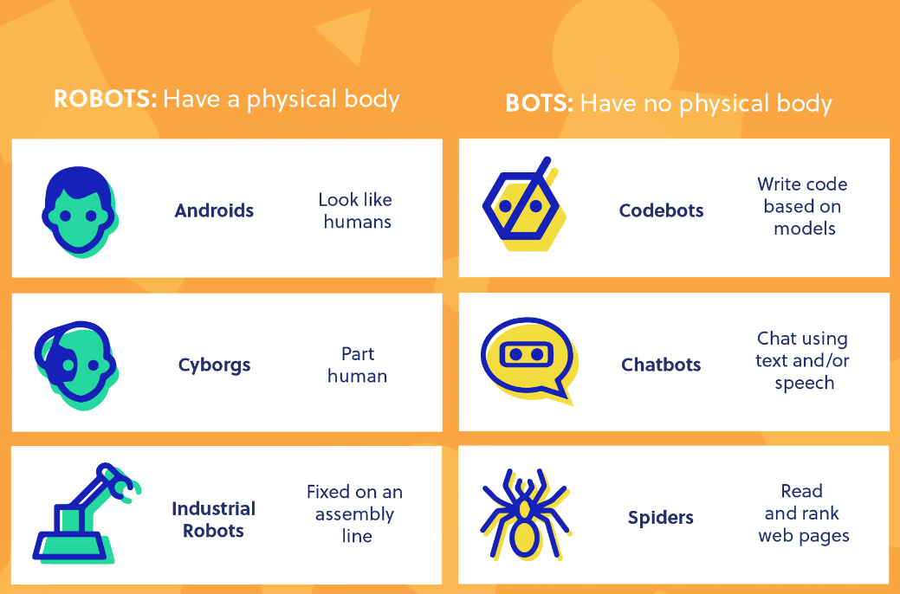
ROBOTS VS RO(BOTS)
Image Credit: Codebot.com
Notes:
What’s interesting are the parallels between androids, robots that look like humans and chatbots, and bots that act like humans.
https://youtu.be/sk1NkWl_W2Y
A cyborg is a human-robot hybrid.
Industrial robots are the robots you see in assembly lines. They are designed to move materials, parts, and tools to complete programmed tasks in manufacturing and production.
They are commonly used to complete duties that are dangerous or unsuitable for human workers.
Originally, “bot” was a shortened version of “robot”, but now it means robots without bodies.
Robots are programmable machines that can automatically execute actions, whereas bots are programs that can automatically execute actions.
A chatbot can live inside a range of existing products/services, such as Facebook Messenger and iPhone (i.e. Siri), or in a custom-made machine, such as Google’s Home device.
A web crawler, or spider, is a type of bot that is typically operated by search engines like Google and Bing. Their purpose is to index the content of websites all across the Internet so that those websites can appear in search engine results.
https://www.cloudflare.com/learning/bots/what-is-a-web-crawler/
https://codebots.com/docs/as-a-developer-why-use-a-codebot

Slide 21
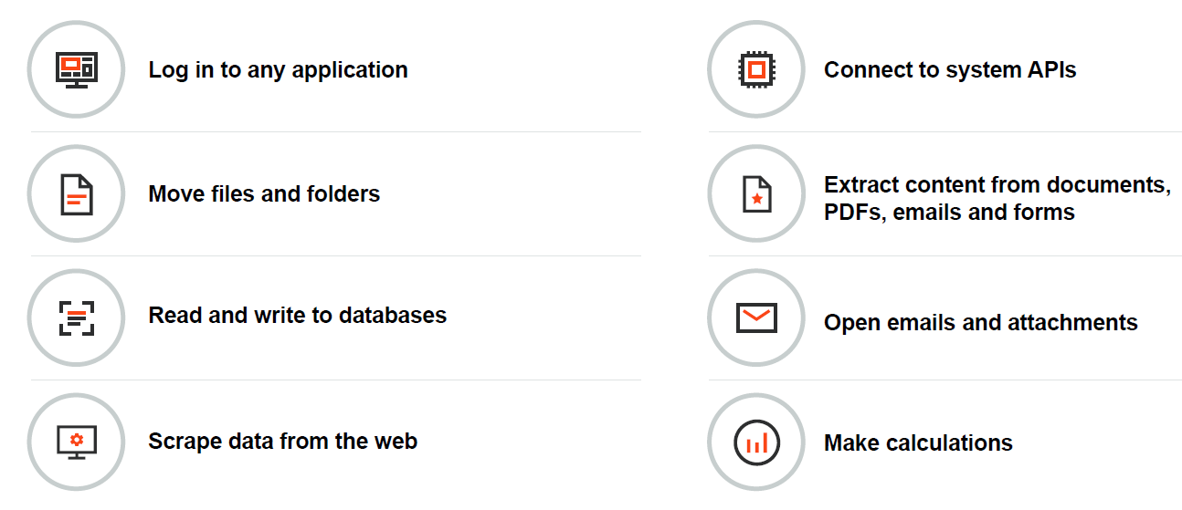
What Robots Can Do ?

Slide 22
Why UiPath?

Slide 23

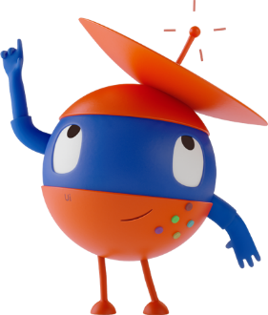
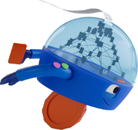
Automation & us
Evolving with speed to accelerate human achievement
Our Mission: To deliver the
Fully Automated EnterpriseTM
Series A
Investment
Our Vision: A Robot for Every Person
Headquarters in New York City
Leader in Gartner Magic Quadrant and Forrester Wave for RPA
#1 in Gartner Magic Quadrant
UiPath founded in Romania
Public company
UiPath Enterprise RPA Platform
Series B & C
investment
Acquired Re:infer
Series D investment
Series F investment
#1 in all major independent user review sites for RPA
Series E investment
STUDIO
ORCHESTRATOR
ROBOTS
AI COMPUTER VISION
AI CENTER
PROCESS MINING
HUMAN
IN THE LOOP
AUTOMATION CLOUD
APPS
SCREEN
SCRAPING
UI AUTOMATION
OCR
TEST SUITE
STUDIOX / ASSISTANT
TASK MINING
2017
2018
2019
2020
2021
2022
2005
2013
THE FULLY AUTOMATED ENTERPRISE

Slide 24

Today: global coverage, local expertise
Toronto
London
Bellevue
Boston
Amsterdam
NYC HQ
Munich
Mumbai
Austin
Paris
D.C.
Bucharest
San Jose
Tokyo
Houston
Bangalore
Hong Kong
Dubai
Seoul
Singapore
Sao Paolo
Sydney
Notes:
This map changes frequently as we are always expanding worldwide
These are the offices we have worldwide
Product development centers: Bellevue, Bucharest and India
Customer support centers: Bucharest and India
Sales, marketing and RPA consultants in all other offices
Head offices at 90 Park Ave in New York City

Slide 25






Users: The UiPath Platform is top-rated
G2
Gartner Peer Insights
Peer Spot
Trust Radius
SoftwareReviews
4.6 out of 5
4.5 out of 5
Peer Spot Award
Top-Rated RPA Software
Top-Rated RPA Solution
Aggregate rating 2022
Aggregate rating since inception
2021
2021
2021
Leader in RPA:
Winner 2021 Emotional Footprint Award
#1 Value for Price (in RPA category)
Customers’ Choice Winner, 2021
Leader in Low-Code
Leader in Test Automation

Slide 26



UiPath Platform
The UiPath Suite has three core components, which are are:
Studio
Orchestrator
Robot
Deploy
Execute
Design automation workflows visually, with minimal use of code
Control, manage and monitor the robots
Execute workflows and instructions

Slide 27

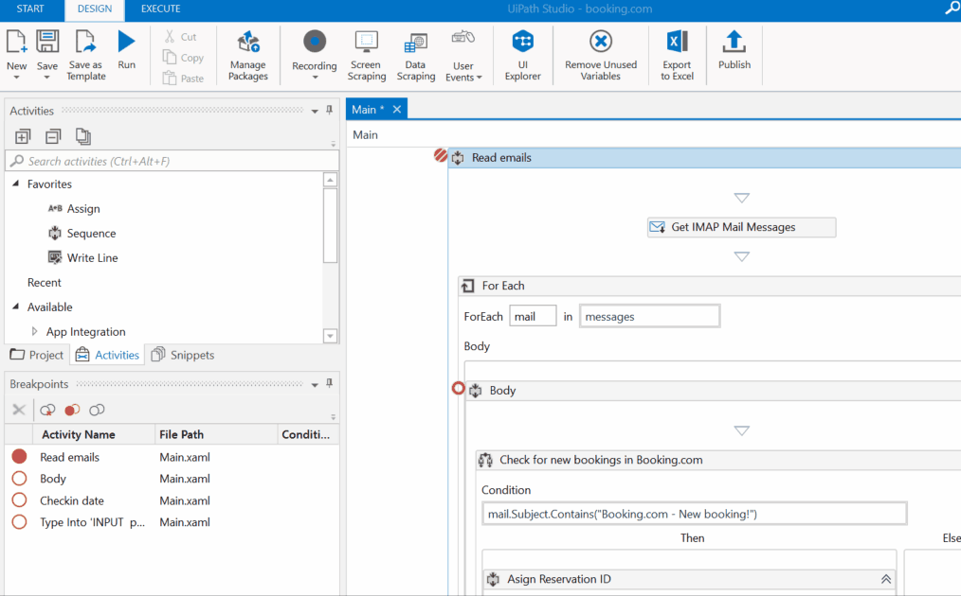
Where RPA Developers design automations visually, building any kind of automation from simple tasks to robots enhanced with AI skills. Its Powerful, user-friendly IDE, to visually design your automation

Slide 28

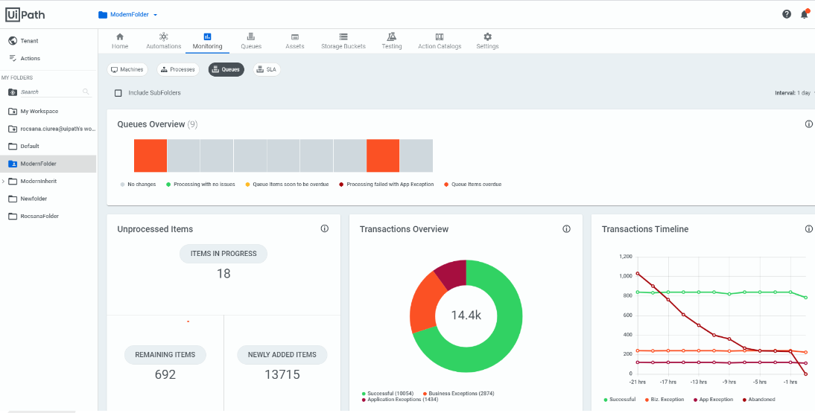
Orchestrator is the heart of your automation management. It gives you the power to deploy, trigger, monitor, measure and track every robot.

Slide 29

Run your automations from a desktop, data center, or the cloud
Robots are your digital helpers.
No Robots
Attended, In Tandem
Hybrid
Fully Unattended
UiPath software robots are intelligent, reliable, flexible, and eager to take on a huge range of tedious tasks.
100% human
Human on computer with Robot process in background
Attended process uses human’s computer to kick off unattended background process
100% automation
Choose attended, unattended, or a bit of both (hybridmodel).
Examples:
Brainstorm with your team
Examples:
HR Robot works with onboarding team to provision a new employee
Examples:
Service Rep turns on Robot to delete customer data from multiple databases as part of a GDPR "right to forget" request
Examples:
Robot processes invoices
Robot loads data into a system like SAP
You decide how your robots work for you...
Attended Robot
Unattended Robot

Slide 30
Install UiPath Studio/StudioX and Plugins
Sign up for your UiPath Automation Cloud account:
Link: https://bit.ly/3rOHDkd >> option on the right side >> sign up for UiPath Automation Cloud for community
Download UiPath Studio/StudioX:
Once inside the Automation Cloud click on the first blue button Download UiPath Studio
Run the UiPath Studio installer
Sign into UiPath Automation Cloud from UiPath Studio
Choose the UiPath StudioX profile
Resources:
https://docs.uipath.com/installation-and-upgrade/docs/studio-install-studio

Slide 31


Build an Automation using UiPath

Slide 32

What’s NEXT?
Join UiPath Student Developer Community https://community.uipath.com/studentdevelopers/
Visit Open Community’s Official Website :https://upes-open.org/
Connect with Student Champion
Have more Questions – Email to :
studentdeveloper@uipath.com

Slide 33

It’s time to win!

Slide 34


THANKS TO OUR CONVENER
Dr. Gourav Bathla Faculty Coordinator UPES Open Community
Mr. Raghav Aggarwal President UPES Open Community​

Slide 35
Time to feedback

Slide 36





Thank You

